Slide 1
Two puzzles of FU Ori objects
Zhaohuan Zhu
Lee Hartmann, University of Michigan

Slide 2
Why outbursts?
What’s happening at the disk/star boundary?
Outbursts in intermediate-mass stars?

Slide 3
Hartmann & Kenyon 1996 ARAA

Slide 4
FU Ori: a rapidly-accreting protostellar disk
inner disk: absorption features (centrally viscous/MRI heated)
outer disk: silicate emission (envelope)
no hot emission (no magnetosphere, boundary layer)
Hartmann, Herczeg, Calvet, 2016 ARAA after Zhu+07

Slide 5
Wide variety of accretion outbursts- different pre-outburst disk structure?

Slide 6
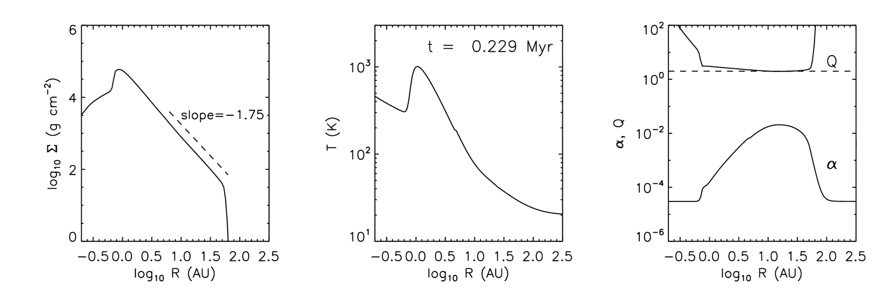
Why outbursts?
General idea (HK): infall to disk > accretion rate through disk (more likely now we know MRI doesn’t work, so low α)
Gravitational instability transport (Armitage, Zhu, Bae) driven leads to triggering of the MRI (+ thermal instability)

Slide 7
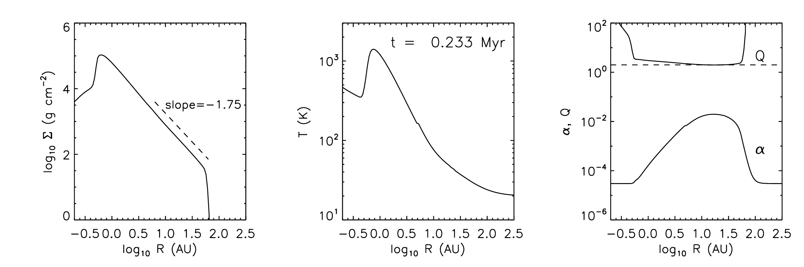
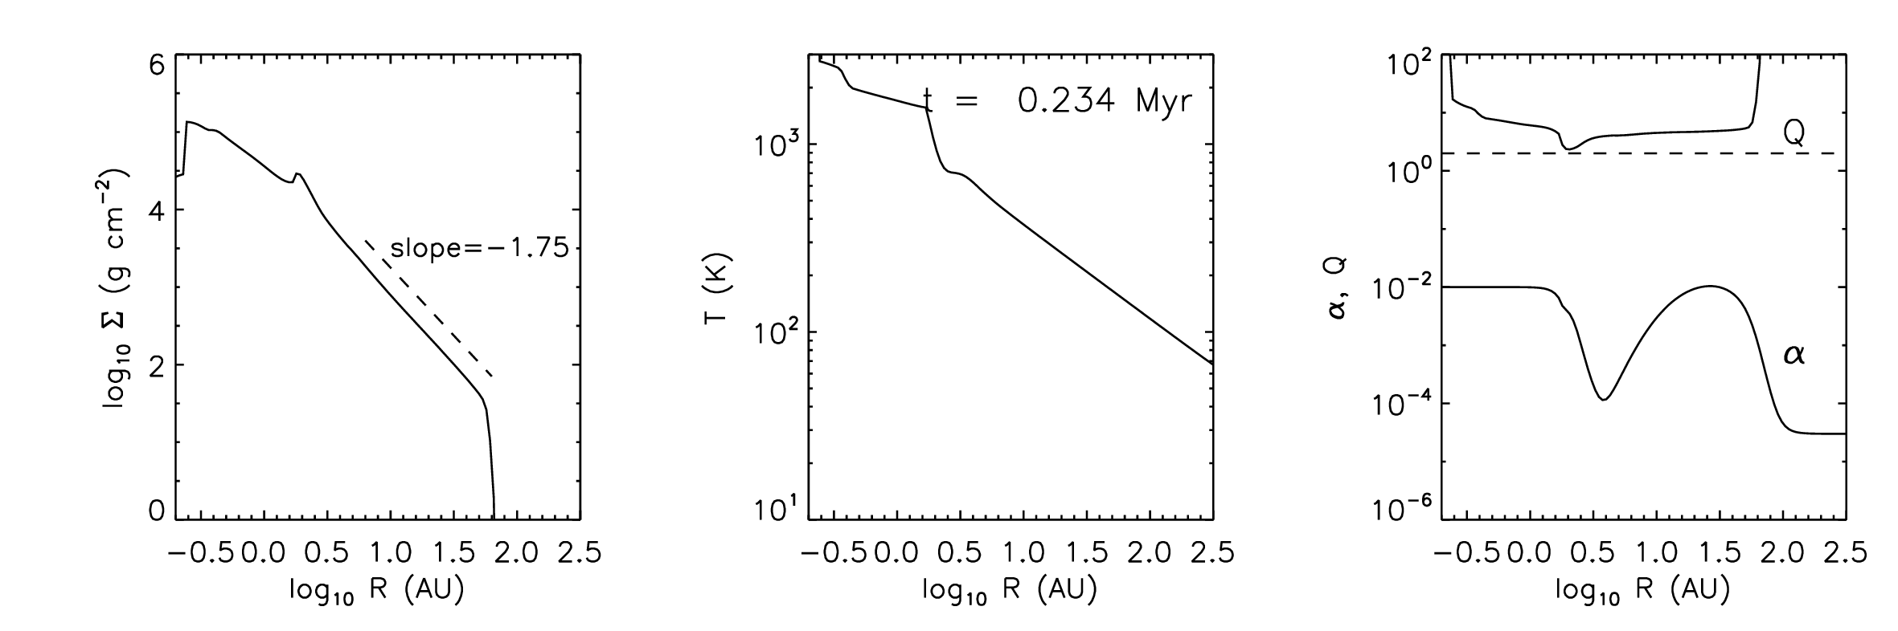
Why outbursts?
alternative: accretion of fragments formed out in the disk (Vorobyov); just starting to address MRI/thermal instability in inner disk
planet gaps –pileup (Clarke)? or accrete planets? Need disk...

Slide 8
Why outbursts??
Both GI + MRI and blob accretion predict outside-in outbursts: fast rise, see it first in IR
V1515 Cyg inconsistent: slow rise ⇒ inside-out (Bell, Lin)
Gaia 17bpi consistent
Hillenbrand+18
n.b.; structure in light curve ⇒ pre-existing disk structure?

Slide 9
T(max) sensitive to inner disk radius R_{i}
Higher T(max) at given accretion rate dM/dt for larger M* /R_{i}³

Slide 10
FU Ori:
L (Gaia d = 416 pc) ~ 160 L⦿
T(max) ~ 6500 K ⇒ R(inner) ~ 4.2 R⦿
dM/dt ~ 1.5 x 10⁻⁴ M⦿ ; ≳ 0.015 M⦿ accreted from R ≲ 1 AU (!)
i = 55º , v(rot) sin i ⇒ M* ~ 0.3 M⦿ ; expected radius ~1.5 R⦿ !!
No magnetospheric accretion – and no boundary layer
L(acc) ≳ 10² L*
⇒ magnetosphere crushed
⇒ star expands ~ 2 → 4 R⦿

Slide 11
What does the large “R_{inner}” mean?
Usual explanation: heating/advection of accretion energy expands the star
  L(acc) > 10² L*
  magnetosphere crushed at high dM/dt
  disk thickness H/R ~ 0.3 ⇒ large fraction of stellar “surface” covered by disk; also, harder for radiation to escape vertically
For low-mass stars, critical accretion rate is of order ≈ 3 x10⁻⁶ M⦿/yr; below, L(acc) ~ 10 L*, magnetosphere not crushed, H/R ≲ 0.1
or non-standard T(r) in complex star/disk interface? Which doesn’t happen in low-L, low-dM/dt systems? excess wind energy loss???

Slide 12
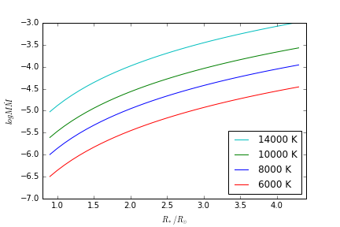
“Classical” FU Ori optical spectral type: G ⇒ T(max) ~ 6000 K;
but the “inner” radius of FU Ori is ~ 2x typical pms R*
FU Ori
Gaia17bpi
For the same accretion rate, but typical R*, T(max) ~ 10,000 K!
Lower dM/dt can look the same optically if R_{i} small

Slide 13
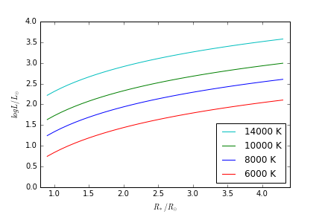
“Classical” FU Ori optical spectral type: G ⇒ T(max) ~ 6000 K
FU Ori
Gaia17bpi
high dM/dt → star expands, but not at lower dM/dt
is T(max) ~ 6000 K accidental? connection to thermal instability?
Gaia17bpi: should it have a magnetosphere??

Slide 14
What would a similar outburst look like for an intermediate-mass star?
⇒ much less likely to have star expand because
L(acc) less important relative to L*
H/R smaller
T(max) higher because no expansion, M*/R* larger;
unless magnetospheric truncation?

Slide 15
Z CMa: ~ 600 L⦿ FU Ori object + ~ 3000 L⦿ embedded HBe
Separation ~ 100 AU
Bonnefoy+ 17
Canovas+12

Slide 16
The FU Ori object shows the typical CO absorption spectrum and water vapor absorption
Hinkley+13
HBe
The HBe shows emission lines superposed on smooth continuum
FU
Bonnefoy+17

Slide 17
High state: optical dominated by emission lines + P Cygni profiles (with some absorption line contribution from the FUor)

Slide 18
Combined object is strongly variable
Outbursts? difficult to tell, possibly a combination of variability in both extinction and accretion

Slide 19
Z CMa
FU: L ~ 500 L⦿ T(max) ~ 7900 K (R / 5 R⦿)^{1/2} - large R? T(r)??
  M* dM/dt = 1.5 x 10⁻⁴ M⦿²/yr
  v sin i ~ 100 km/s; i ~ 60º ⇒ M ~ 1 M⦿
HBe: suppose M ~ 2.5 M⦿, R ~ 2.5 R⦿ (maybe doesn’t expand because L*/L(acc) not so extreme?)
  dM/dt = 2 x 10⁻⁴ M⦿/yr:
  L(acc) = 3000 L⦿, T(max) ~ 17,000 K
The HBe object certainly has a rapidly-accreting disk (strong wind, CO disk emission).
No absorption features. Are we seeing anything but a hot disk? (see talk by Aurora Sicilia-Aguilar)

Slide 20
Summary
FU Ori outbursts require massive inner disk
Triggering of the MRI involved
Reason(s) for the outbursts not clear; GI driving, blob accretion possible
Different mechanisms? Inside-out cases? (V1515 Cyg)
“FU Ori” T(max), optical spectra can be seen in both low and high L(acc) systems; difference due to large “inner radius” at high dM/dt
Rapid accretion/bursts in intermediate-mass stars?
  expect high Tmax (~ 10⁴ K or more)
  Could some “HBe” stars really just be rapidly-accreting disks around A-F central stars?

Slide 21
FU Ori:
pre-outburst: L ~ 1 L⦿, R ~ 2 R⦿
outburst: L ~ 250 → 160 L⦿, R(inner) ~ 4.2 R⦿
~ 6000 K
T ≳ 5 x 10⁴ K!
expansion of star – irradiation, advection of energy from disk
what is the inner region really like??

