Slide 1



Revealing the Two ‘Horns’ of Taurus with Gaia DR2
Graham D. Fleming, Jason M. Kirk, Derek Ward-Thompson & Kate Pattle
Presented by: Graham Fleming
at the STARRY 2019 Conference – 20 June 2019
Image: ESA/NASA - Five College Radio Astronomy Observatory (FCRAO), Gopal Narayanan / Mark Heyer
Notes:
Personal introduction – 1st year Masters (Research) post-graduate at UCLan looking at the structure of the Taurus Cloud using data from Gaia DR2.
Presenting initial findings submitted to ArXiv Archive and ApJ ...... currently under referee process .....

Slide 2
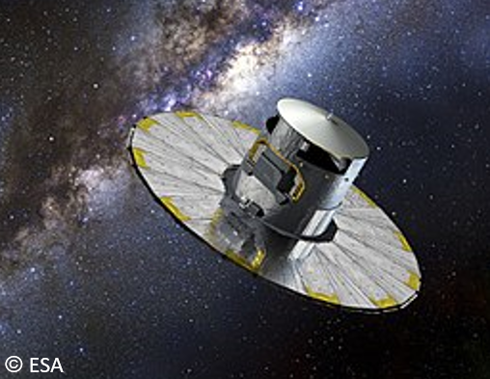
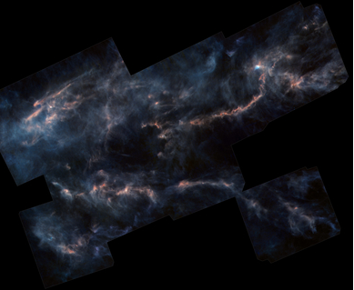
SOME BACKGROUND INFORMATION
Gaia Space Observatory
Taurus Molecular Cloud
© ESA/Herschel/NASA/JPL-Caltech
Launched in 2013 by ESA.
Optical astrometric telescope.
Designed to measure the parallax, positions, and motions of more than one billion stars.
An accepted distance of 140 parsecs (430 light-years).
One of the nearest and best-studied low-mass star forming regions.
Recent study by Luhman (2018).
Luhman, K.L. (2018), ApJ, 156, 271
Notes:
Introduction to Gaia mission and quick overview – data available on-line in Gaia Archive
Herschel far-infrared image of TMC.
Work done by Kevin Luhman in parallel with ours...

Slide 3
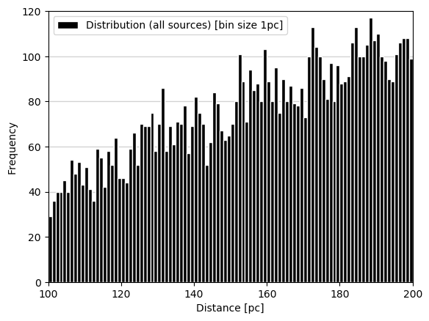
GAIA ARCHIVE SEARCH
ADQL ‘box’ search: 7587 sources returned
Notes:
Sources binned at 1pc.
No expected peak in distribution at 140 pc
Can see an increasing slope of graph due to Square Law
Needed to look at spatial distribution to look for any patterns…..

Slide 4
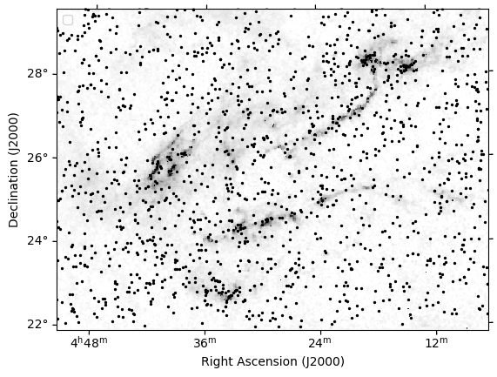
DISTRIBUTION OF SOURCES IN TMC
Background image: Schneider, N., et al.( 2011), A&A, 529, A1, Figure 3
Notes:
7k sources overlaid on a visual extinction map from Schneider et al. (2011) – (indicate reference on slide)
No clear distribution pattern.....can see field stars everywhere.........some ‘over densities’ seen around some of the cloud complexes
Needed to reduce the field for initial study.......

Slide 5
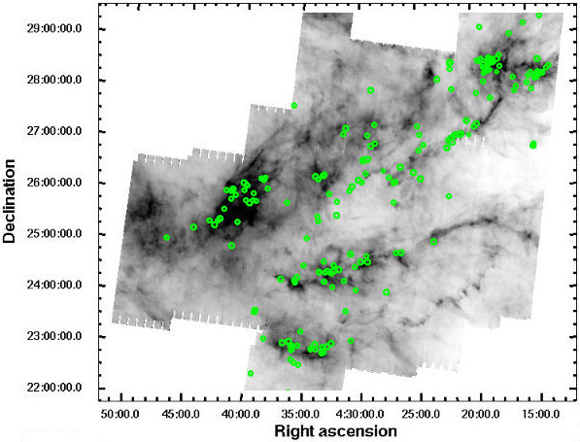
DATA REDUCTION
Image: Rebull, L.M., et al.( 2010), ApJS, 186, (2), 259-307, Figure 8
Notes:
Decided to use the Spitzer sources from Rebull et al 2010 study (Table 6) and cross-match to our DR2 sources.
Using this data ‘cut’ has reduced the number of sources and given use 168 sources in both data sets.

Slide 6
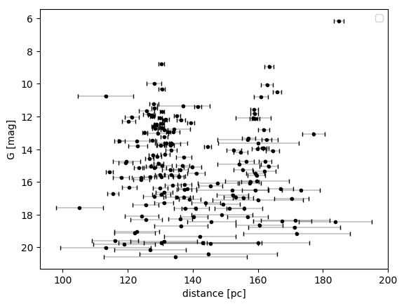
GAIA – SPITZER CROSS MATCH
Notes:
Extracting the Gaia G-band magnitude and parallax data (with its errors) and converting to distance STILL did not produce the expected population around 140 pc.
This is a plot of our 168 sources plotted with distance against G-magnitude.
Can see larger errors at lower magnitudes as expected.
Can see that the distribution is starting to show 2 peaks.

Slide 7
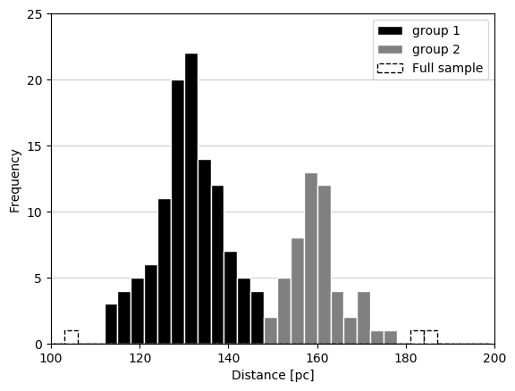
DISTANCE DISTRIBUTION
168 sources binned at 3pc.
2 distinct groups identified.
Notes:
Binning the sources at 3pc and plotting confirmed two ‘peaks’ in the distribution.
PROBLEM......Referee not convinced we had clearly found a double-peaked distribution !!, IS THE REFEREE IN THE AUDIENCE??

Slide 8
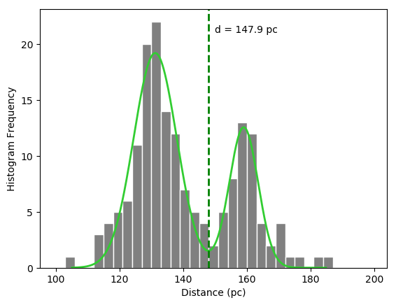
IDENTIFICATION OF GROUPS
Double gaussian fit suggests two populations.
First peak:
130 ± 16 pc (FWHM).
Second peak:
160 ± 11 pc (FWHM).
Notes:
Fitting a double Gaussian curve clearly identifies the groups.
Major peak at ~ 130 pc
Minor peak at ~ 160 pc
Minimum distribution of sources found to be at ~ 148 pc

Slide 9
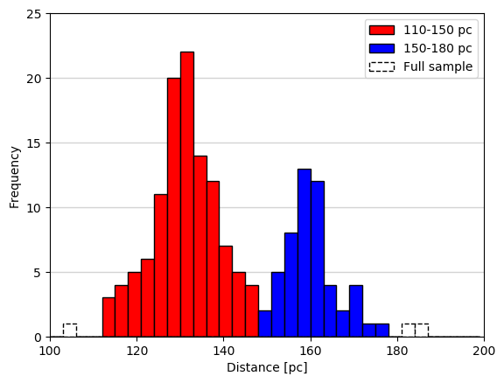
THE TWO ‘HORNS’ OF TAURUS
Near and Far groups identified.
THE TWO HORNS
Notes:
Distribution split into two groups:....taking minimum (148 pc) from distribution (last slide) to be 150 pc
‘near’ group: between 110 – 150 pc, 113 sources
‘far’ group: between 150 – 180 pc, 52 sources
Decided to see how these populations clustered on the cloud.....

Slide 10
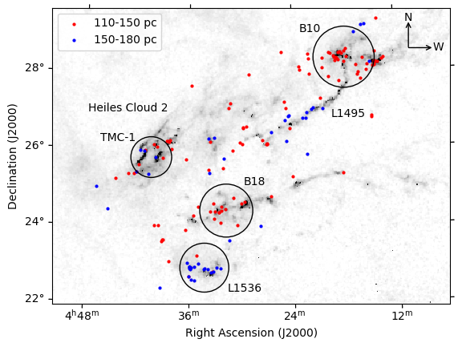
SPATIAL DISTRIBUTION & CLOUD STRUCTURES
Notes:
Plotting spatial distribution of the two populations shows that the distribution is linked to individual cloud regions and structures.
Having identified two distinct populations.....decided to look at their proper motions....

Slide 11
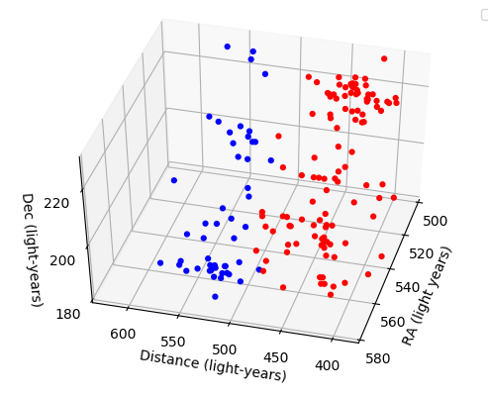
3D SPATIAL DISTRIBUTION
Notes:
One of the main aims of this study....to produce a 3D model of the TMC.
Plot shows initial results using the sample identified.

Slide 12
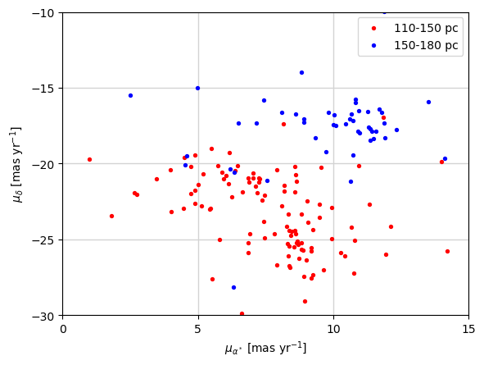
DEFINING THE PROPER MOTION POPULATIONS
20.1 ± 2.4 mas/yr
24.5 ± 2.8 mas/yr
12 to 40 mas/year ‘cut’ identifies some outliers in each group
Centres identified using k-Means clustering analysis
‘Near’ and ‘far’ groupings identified with mean values shown..
Notes:
Having identified two proper motions in the sample....decided to look again at the spatial distribution on the cloud...

Slide 13
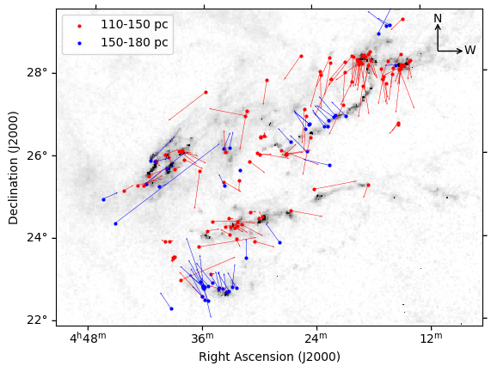
MEAN MOTIONS OF ‘NEAR’ AND ‘FAR’ GROUPS
Notes:
Star velocity vectors projected with individual proper motions subtracted from their mean group value
Wide range of motions within the TMC ......apparently linked to cloud structures

Slide 14
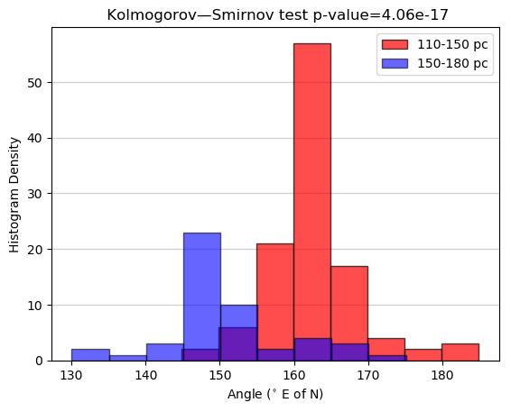
KOLMOGOROV–SMIRNOV ANALYSIS
Statistical analysis using proper motions.
p-value of ~ 10⁻¹⁷
Confirms that populations are
bi-modal.
Notes:
Another stats test ......this time using the proper motion data.
Note red and blue groups swopped over.....this is because we are plotting against ANGULAR MOTION wrt degrees E of N

Slide 15
CONCLUSIONS
We have investigated the spatial properties of 168 members of the Taurus star-forming region which appear in Gaia DR2 and which also appear in the Spitzer catalogue.
We find two independent populations of stars in the TMC with a
  ‘near’ group centred at 130 ± 16 pc at FWHM, and a
  ‘far’ group at centred at 160 ± 11 pc at FWHM.
The two associations have different proper motions of
  24.5 ± 2.8 mas/year, and
  20.1 ± 2.4 mas/year for the ‘near and ‘far’ groups respectively.
The spatial location of the two groups is closely linked to individual cloud structures.

Slide 16
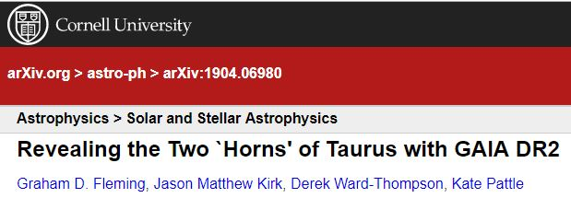
ArXiv Reference
Available at: https://arxiv.org/pdf/1904.06980.pdf
Notes:
Blatant publicity - THANK YOU ☺

Slide 17
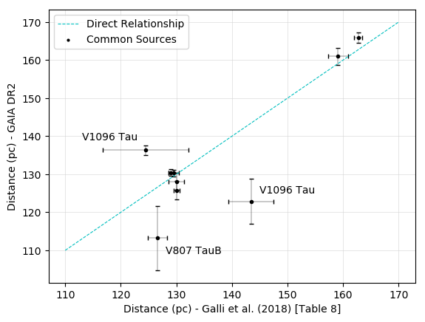
GAIA and VLBI ERROR COMPARISON
Extra 1
Notes:
Comparing the Gaia errors with those sources found in the Galli et al. (2018) sample

Slide 18
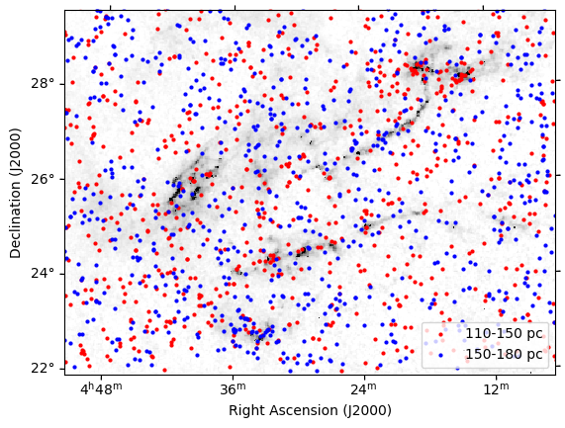
DISTRIBUTION OF ALL 7k QUERY SOURCES
Extra 2
Notes:
7k distribution split using near and far parameters

Slide 19
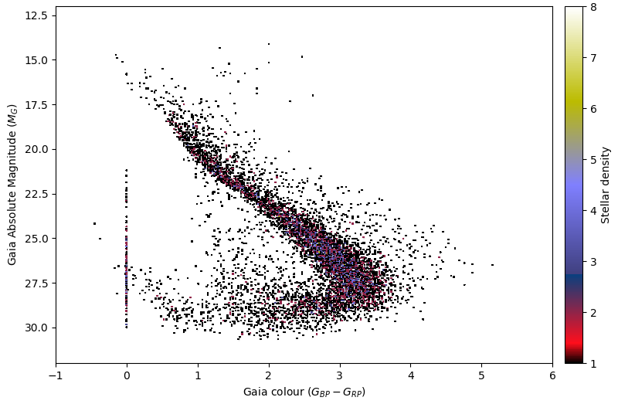
INITIAL LOOK AT TMC IMF
Extra 3
Notes:
CMD of Absolute Magnitude of 7k sources – not extinction corrected

Slide 20
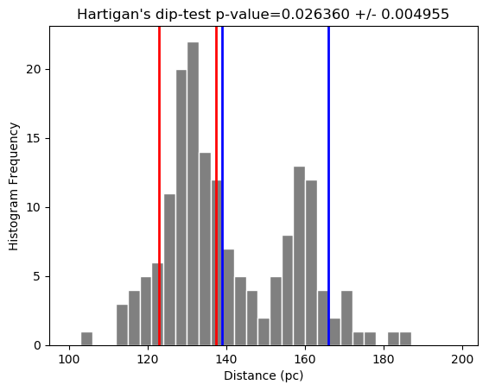
STATISTICAL ANALYSIS OF GROUPS
p-value < 0.05.
Distribution NOT unimodal.
2 distinct groups identified.
Extra 4
Notes:
Statistical analysis of distribution using Hartigan’s Dip Test finds a p-value of ~ 0.026 which is an indicator of multi-modality.

